Slide 1
Decimal and Fraction
Decimal system the value of a digit depends on it’s place or position in the number. Each place has a value of 10 times the place to the right. Face value of a number is the value of the number without regard to where it is in relation to another number.
Ex- 7 always has a face value of 7, whether it belongs to 247 or 742. How ever the place value includes the position of the number in another number.
Ex. In number 4732, 7 has a place value of 700 but have a face value of just 7.

Slide 2
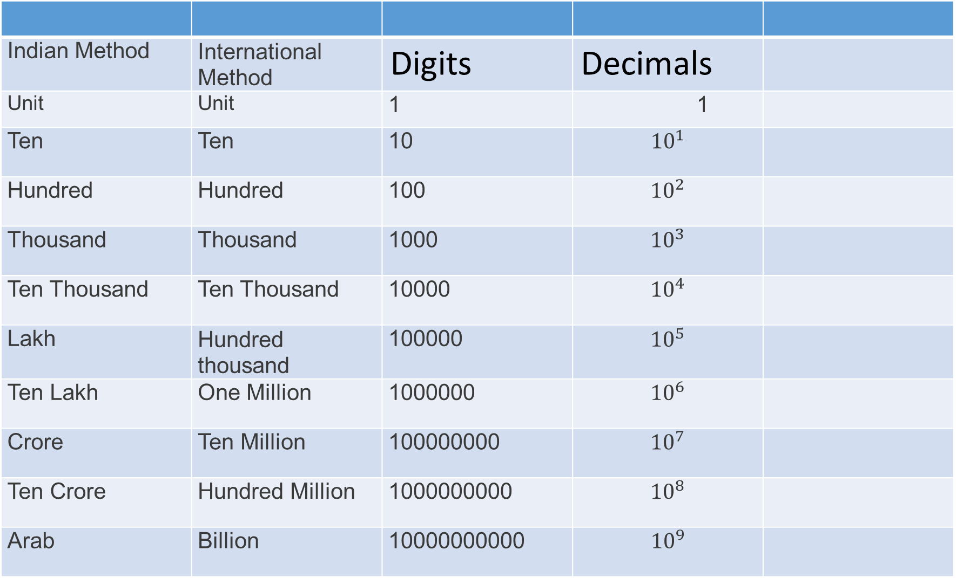
Names of digits according to their place value.
Indian Method | International Method | Digits | Decimals
Unit | Unit | 1 | 1
Ten | Ten | 10 | $${10}^{1}$$
Hundred | Hundred | 100 | $${10}^{2}$$
Thousand | Thousand | 1000 | $${10}^{3}$$
Ten Thousand | Ten Thousand | 10000 | $${10}^{4}$$
Lakh | Hundred thousand | 100000 | $${10}^{5}$$
Ten Lakh | One Million | 1000000 | $${10}^{6}$$
Crore | Ten Million | 100000000 | $${10}^{7}$$
Ten Crore | Hundred Million | 1000000000 | $${10}^{8}$$
Arab | Billion | 10000000000 | $${10}^{9}$$

Slide 3
Fraction
Fraction is a rational number of the form $\frac{p}{q}$, q $≠$0, p is called as numerator and q is called denominator.
Example $\frac{1}{2}$, $\frac{1}{5}$, $\frac{5}{7}$, etc
Remember
If the denominators of all the given fractions are equal then the fraction with greater numerator will be the greater fraction.
Ex- $\frac{4}{7}$, $\frac{2}{7}, \frac{8}{7}, \frac{9}{7}, \frac{5}{7}$ then $\frac{9}{7}> \frac{8}{7}$> $\frac{5}{7}$ > $\frac{4}{7}$ > $\frac{2}{7}$

Slide 4
Remember Formula
If the numerators of all the given fractions are equal then the fraction with smaller denominator will be the greater fraction.
EX-$\frac{7}{4 }$ , $\frac{7}{2 }$, $\frac{7}{8 }$, $\frac{7}{9 }$, $\frac{7}{5 }$ then $\frac{7}{2 }$ > $\frac{7}{4 }> \frac{7}{5 }$ >$\frac{7}{8 }$ >$\frac{7}{9 }$
When numerator is greater than denominator and the differences of numerator and denominator are equal, then the fraction with smaller numerator will be the greater fraction.
Ex. $\frac{5}{2 }$, $\frac{7}{4 }$, $\frac{11}{8 }$, $\frac{8}{5 }$,$\frac{10}{7 }$ then $\frac{5}{2 }$> $\frac{7}{4 }>$ $\frac{8}{5 }$ >$\frac{10}{7 }$ >$\frac{11}{8 }$

Slide 5
Quicker method( cross multiplication)
We can compare fractions by this method and easily take a decision.
Example- $\frac{11}{8 }$ ? $\frac{7}{5 }$ smaller or greater. Ans. By cross multiplication 11x5=55 and 8x7=56 and 55 < 56 then $\frac{11}{8 }$ < $\frac{7}{5 }$
Thank you

